Slide 1
Next Gen RDM EFACTS TESTMANAGER
Work Slides

Slide 2
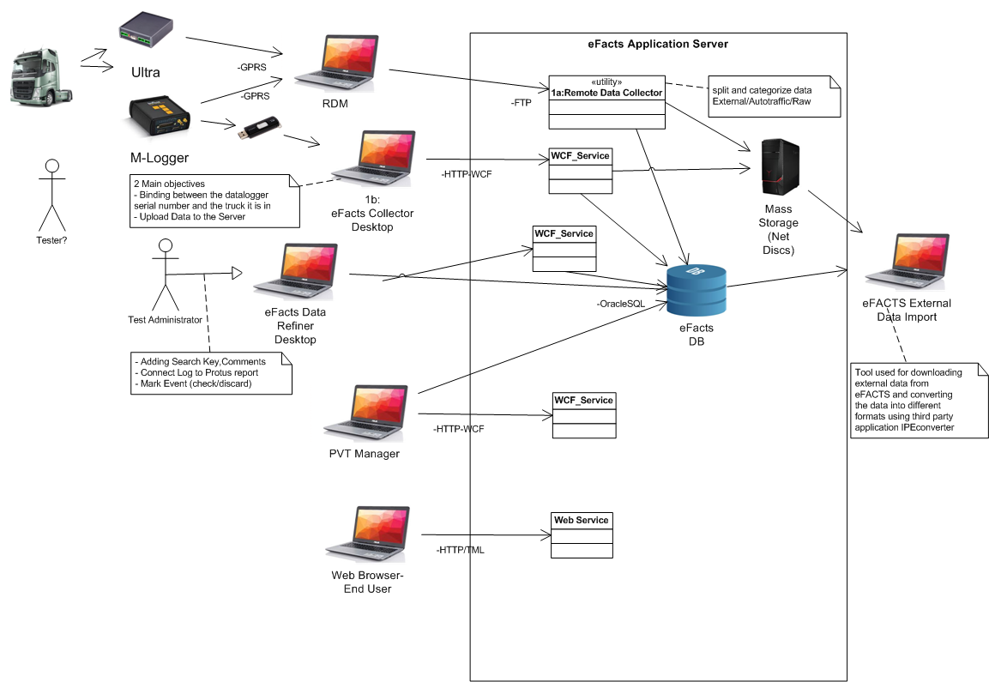

Slide 3
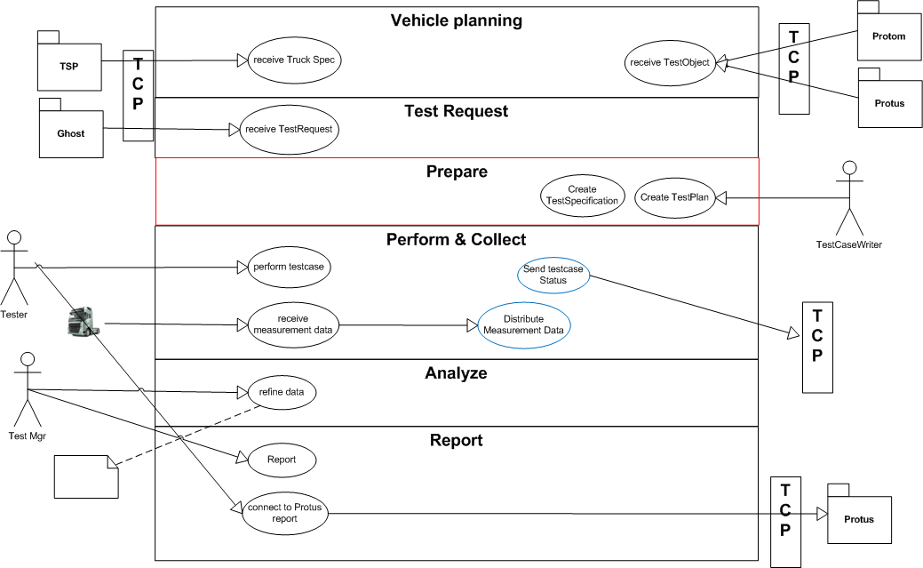
EPIC model

Slide 4
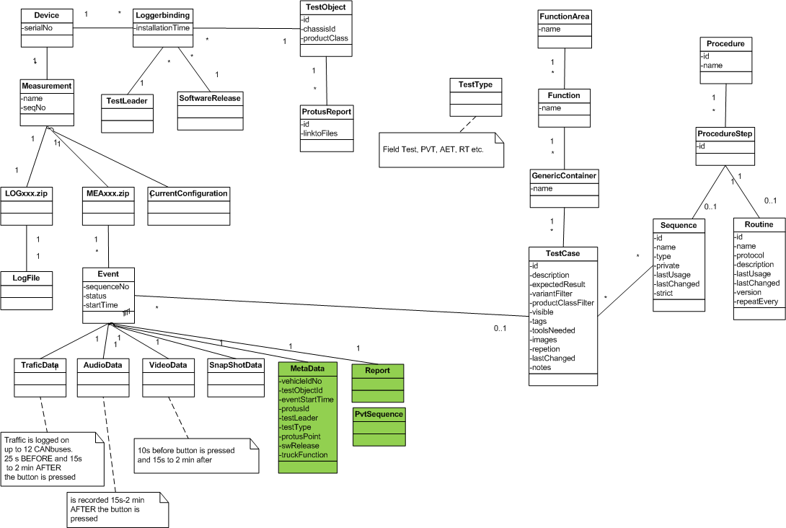
Entity model

Slide 5
Architectural skeleton – info flows

Slide 6
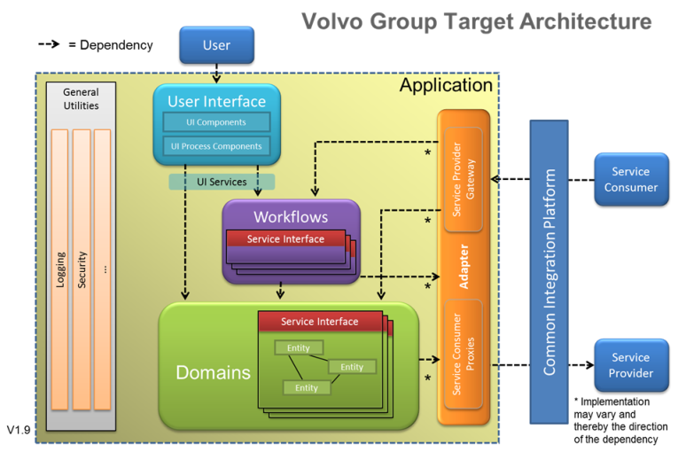

Slide 7
Technologies to be used

Slide 8


Enterprise Architecture Definition
Project vision
Full pyramid
Enterprise Architecture
Process requirements ?
Solution Architecture
Business
Strategy
& Objectives
Info model requirements ?
BUSINESS
Business Architecture
Functional/
Non-Functional
requirements ?
Business Processes
Information
Information Architecture
Infrastructure requirements ?
Application
Application Architecture
IT
Application Infrastructure
Infrastructure Architecture
Core Infrastructure
Enterprise Architecture describes the structure and guiding principles governing the development and implementation of enterprise's information systems. (The Open Group)

Slide 9
Identifying Architecture

Slide 10
